Slide 1
Social embeddedness of traditional irrigation systems in the sonoran desert: a social network approach
By Alan Navarro
December 2nd, 2011; Tucson, Az.

Slide 2
Introduction
Irrigation is very important for arid and semiarid lands.
Irrigation in most of the cases require the mobilization of society resources to build and maintain the irrigation infrastructure.
Irrigation in arid lands imply the control and mangement of a scarce poductive factor and the subsequent appropiation of its agricultural outputs.

Slide 3
introduction
Common property (or CPR) has been considered as a cause creating “perverse” incentives in the use of natural and man-made resources, these “perverse” incentives usually lead to the over use, degradation, and destruction of the productive capacity of the resource.
Irrigation is a man-made CPR: irrigation infrastructure maintenance → provision issues; water and irrigation system (IS)usage (time) → appropiation issues.
IS represents an arena where multiple heterogeneous interests are interacting.

Slide 4
introduction
For a long time it was considered that collectivities were condemded to fall into the destructive spiral created by the CPRs´perverse incentives.
Collectivities needed external help through government or market regulation.
But, scholars started to look at cases where communities had succed managing their CPR w/o external help.
Among these communities were the traditional irrigation systems (TIS).

Slide 5
Problems (policy makers)
The relevance of organization (institutions) for the sustainability of IS (e.g. escaping “The Tragedy of the Commons” (Hardin, 1968)).
The strong attach of policy makers to the “external” solutions to social dilemmas.
Disregard of the complexity (and invisibility) of local forms of arragements devised to escape social dilemas.
Confusion of “optimum” (whatever) with “sustainability”.
Social Capital (e.g. institutions) is just another production input not a panacea.

Slide 6
Previous scholarly approach
Scholars started to look at cases where communities have succed managing and exploiting CPRs.
Research inquired about regularities across case studies which apparently contributed to explain their success.
See Ostrom and Benjamin (1993); Agrawal, (2001); Saker and Itoh, 2001; among others.

Slide 7
This study…
Studies across cases look at regularities of local forms of institutions (social norms) and relate them with some sustainability dimension (e.g. state of the irrigation infrastructure, cropping intensity, etc).
This research looked at factors within a case study which migth contribute to the apperance of social norms. More particularly: social embeddedness.

Slide 8
objectives
To unveil the undelying social structure of a group of irrigators within a traditional irrigation system.
To assess the factors affecting the TIS´s sustainability.

Slide 9
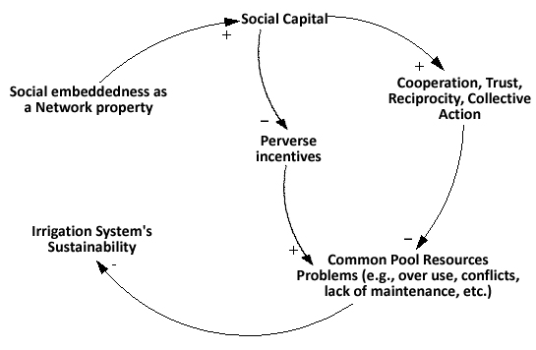
The proposed causation

Slide 10
This study…
This study did not directly test the relation between “social embeddedness” and “sustainability” of TIS, instead just unveils the presence of economic exchanges embedded on other important social contexts. Theoretically argues that this mesh of social ties condition economic exchanges through challenging the assumptions supporting the apperance of social dilemmas.

Slide 11
Two general questions
Are the irrigators socially embedded?
Is the TIS case sustainable (that is, a successful case)?

Slide 12
Methodology
Case study approach
Mixed Methodology: Qualitative and Quatitative
Rapid Rural Appraisal (Qualitative)
Social Network Analysis (Quantitative)

Slide 13
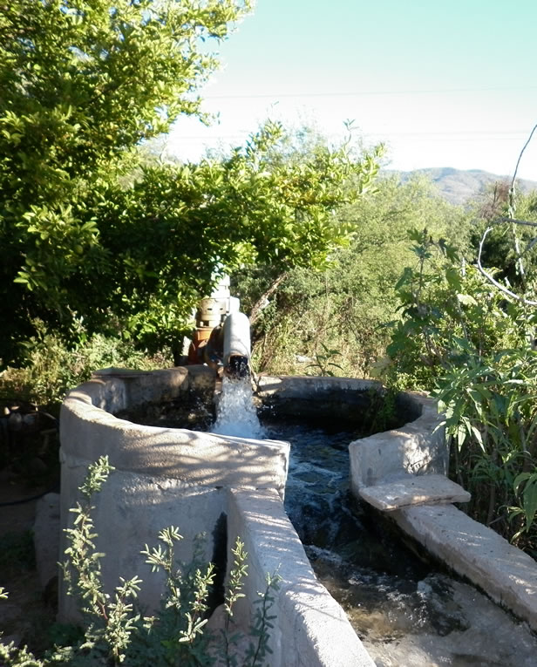
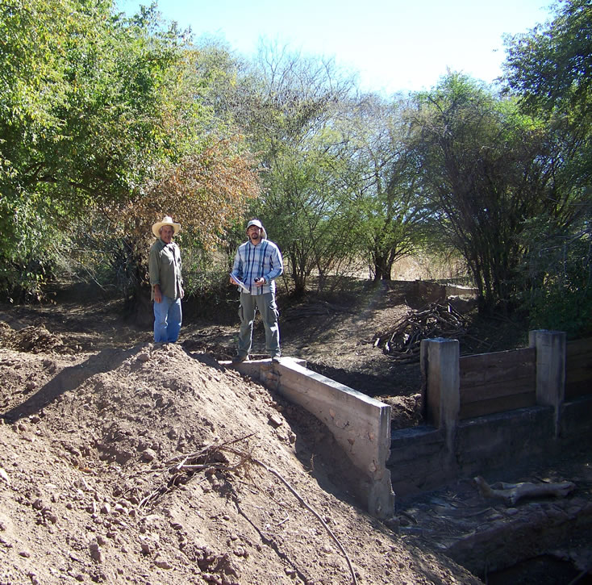
Case studies
Rancho viejo (“old ranch”)
General mariano escobedo

Slide 14
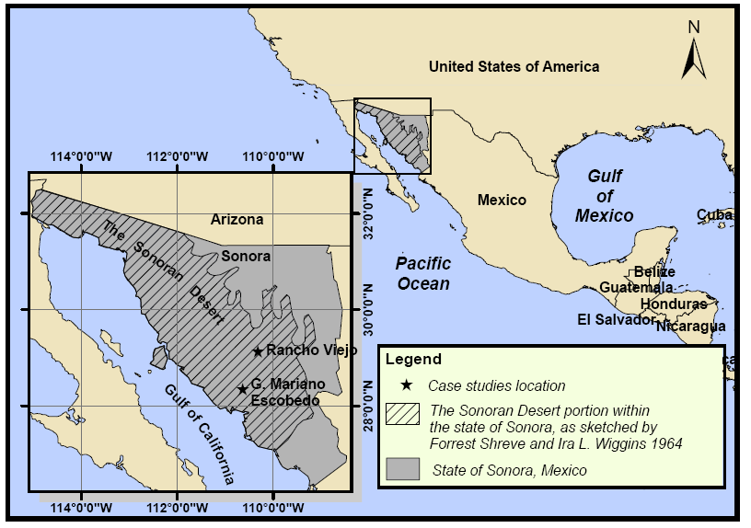
Case study locations
Two case studies located in the Northwestern state of Sonora, Mexico
Both cases located within the Sonoran Desert
GME →Arid lands
RV →Semi –arid lands
Case study → Traditional Irrigation Systems (TIS)
Selection of the case studies: by convenience
Social embeddedness of traditional irrigation systems in
The Sonoran desert: a social network approach

Slide 15
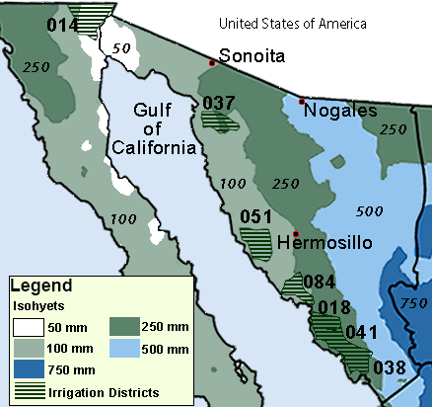
What is a traditional irrigation system (TIS)?
There is no formal definition
They are also known as: “farmer managed systems” and “Irrigation self-organized systems”.
Administratively , in Mexico there are two forms of irrigation: irrigation units and irrigation districts.
Irrigation units a broad category which includes TIS
Official counting of irrigation units in Sonora: 925
TIS features (defined by the author):
Geographically clustered
Small-scale
A rural village
Agriculture as part of their livelihood strategies
Collective use of irrigation infrastructure
Non formal organization
Local technologies
Tradition path-dependency
Social embeddedness of traditional irrigation systems in
The Sonoran desert: a social network approach

Slide 16
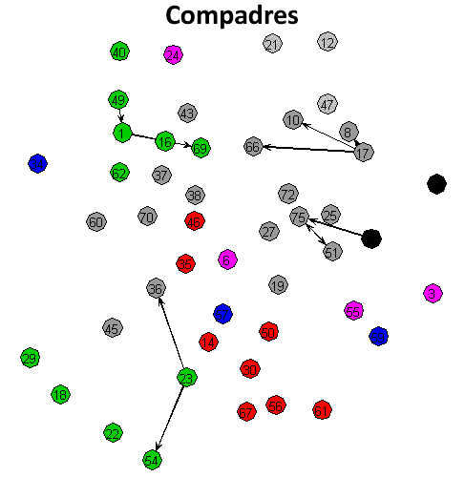
What is social embeddedness?
A concept from new economic sociology, it confronts the individualistic approach of neoclassical economic models.
The concept was first mentioned by Karl Polanyi in 1944, but was popularized recently by Mark Granovetter (1985).
The economic behavior of individuals is constrained by ongoing social relationships.
Social embeddedness of traditional irrigation systems in
The Sonoran desert: a social network approach
Rancho Viejo Case Study

Slide 17
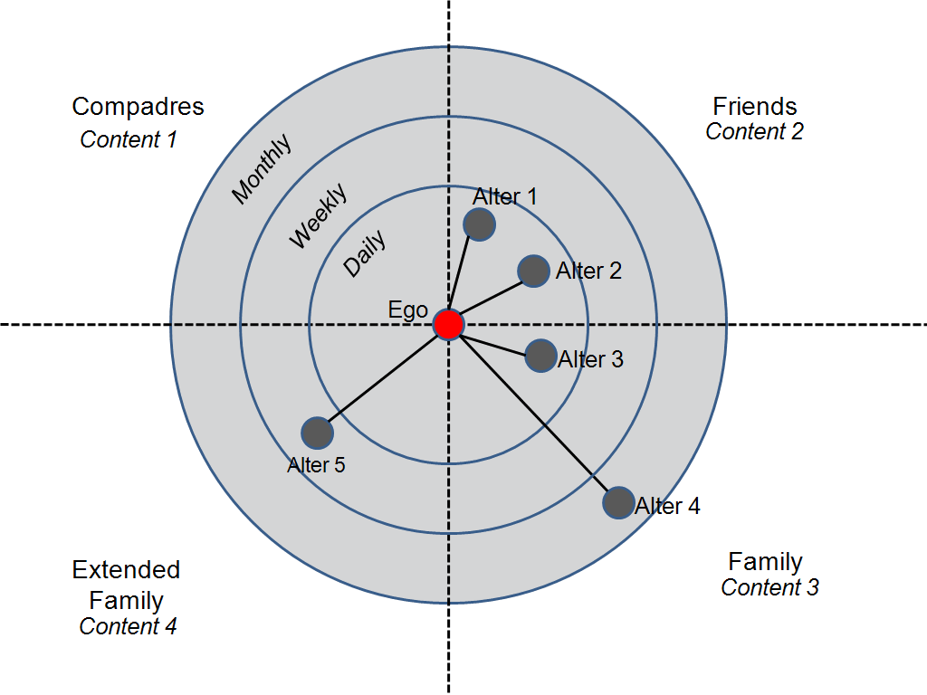
Social networks approach
A TIS is formed by a finite set of individuals which are represented as vertices.
Collective action (partnership, cooperation, etc) is a relational variable, which is represented as egdes.
A social network (or a graph) is formed with a set of vertices and the set of edges connecting them.
NETWORK MAPPING STRATEGIES
A list of membership of the TIS
Interview all the irrigators.
Face-to-face interviews.
Name generator and Name interpreter.
Second hand relational data.
Social embeddedness of traditional irrigation systems in
The Sonoran desert: a social network approach

Slide 18
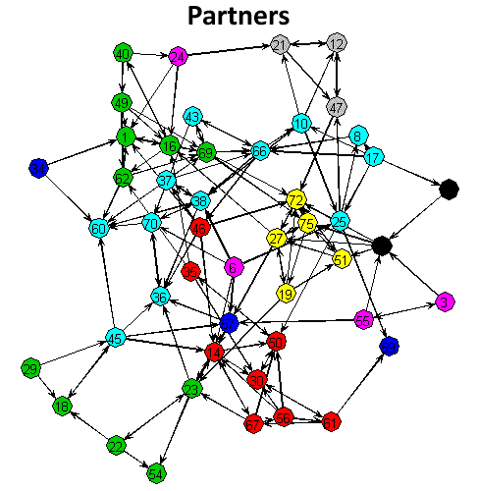
Social networks approach
A TIS is formed by a finite set of individuals which are represented as vertices.
Collective action (partnership, cooperation, etc) is a relational variable, which is represented as egdes.
A social network (or a graph) is formed with a set of vertices and the set of edges connecting them.
Put all them together to form a collective graph.
Social embeddedness of traditional irrigation systems in
The Sonoran desert: a social network approach

Slide 19
Social networks approach
Strategy 1
Strategy 2
Descriptive.
Analyze a list of membership.
Explores the construction of a network of kinship ties using a “match algorithm” which compares irrigators´s pairs of surnames.
Represents family ties within the rural village.
Inferential.
Everytime someone maps a network, guess what? S/he will come up with a social network. Somehow interviewees are pushed to nominate persons, considering a bounded population, it is likely to have socially embedded farmers just by chance.

Slide 20
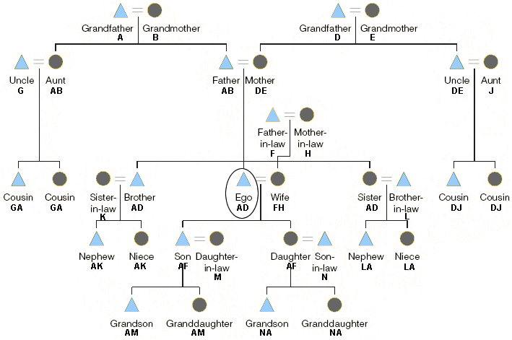
Social networks approach
Strategy 1
Strategy 2
Exponential Random Graph Model (see Robins et al 2007).
Binary dependent variable: is him/her someone with whom [you] would partner up to develop a project within the IS? Yes = 1, No = 0
Farmers migth be socially embedded, but is it affecting their economic decisions?
What relational variables are conditioning the willigness to work with?
Test against randomness
Patronimic naming convention used in Mexico

Slide 21
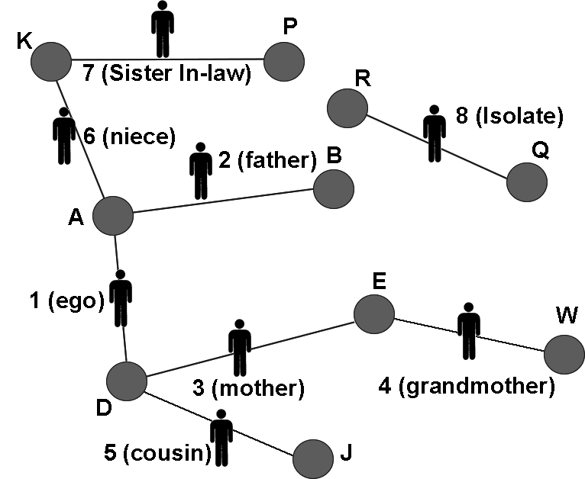
Social networks approach
Strategy 1 hypotheses
Example proxy kinship network
H 1.1 a proxy kinship network derived from a membership list of a TIS, where persons sharing at least one surname are considered as “direct family”presents a “substantial agreement”with the real family relationships.
H 1.2 It is possible to predict extended family relationships “closing” the triangles formed in the proxy kinship network.
Derived from the Family Tree of the last slide

Slide 22
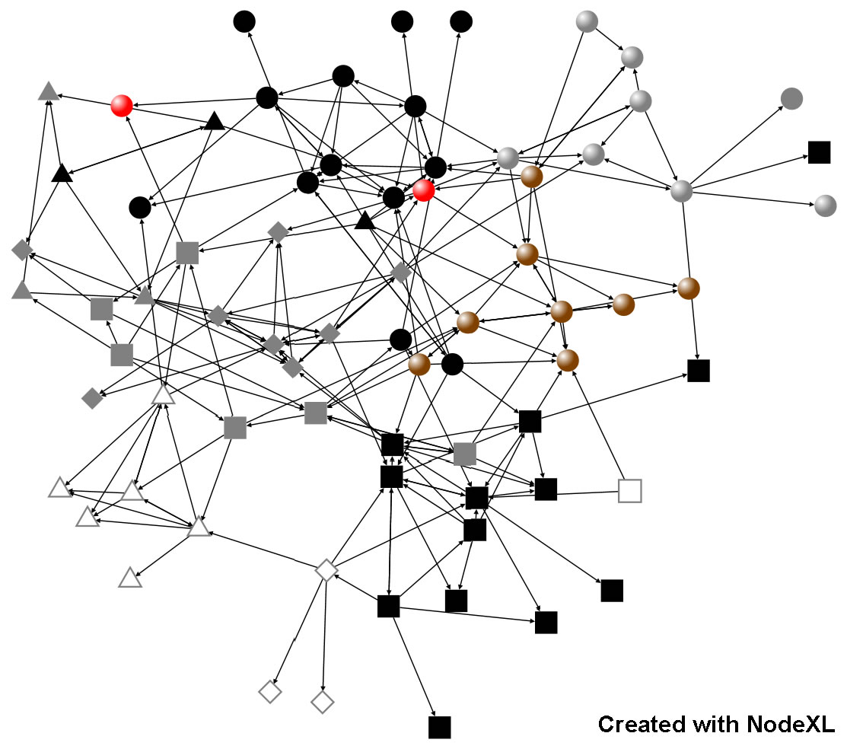
Social networks approach
Strategy 2 hypotheses
Example structured
H 2.1 random distribution of cooperative relations as a global null hypothesis, so the mapped network structure does not govern ties preferences.

Slide 23
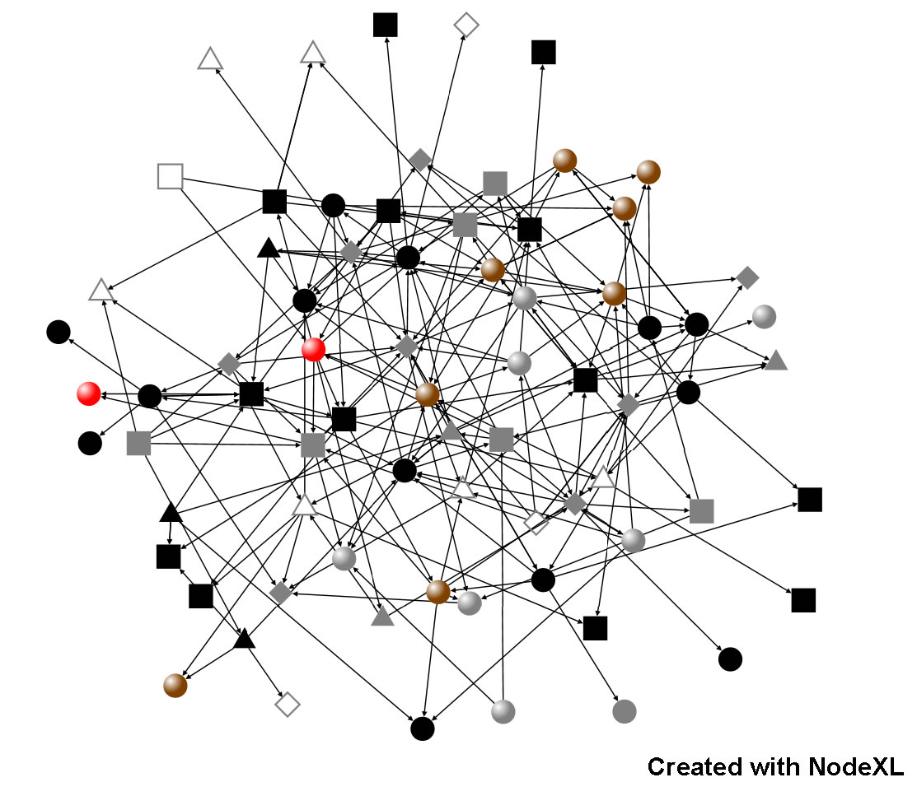
Social networks approach
Strategy 2 hypotheses
Example random
H 2.1 random distribution of cooperative relations as a global null hypothesis, so the mapped network structure does not govern ties preferences.

Slide 24
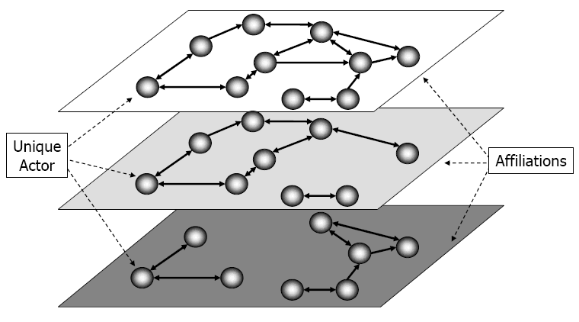
Social networks approach
Strategy 2 hypotheses
Example multiplexity
H 2.2 family homophily is a salient factor in the formation of partners´ties.
This is also known as multiplexity
Image from Hamill (2006)

Slide 25
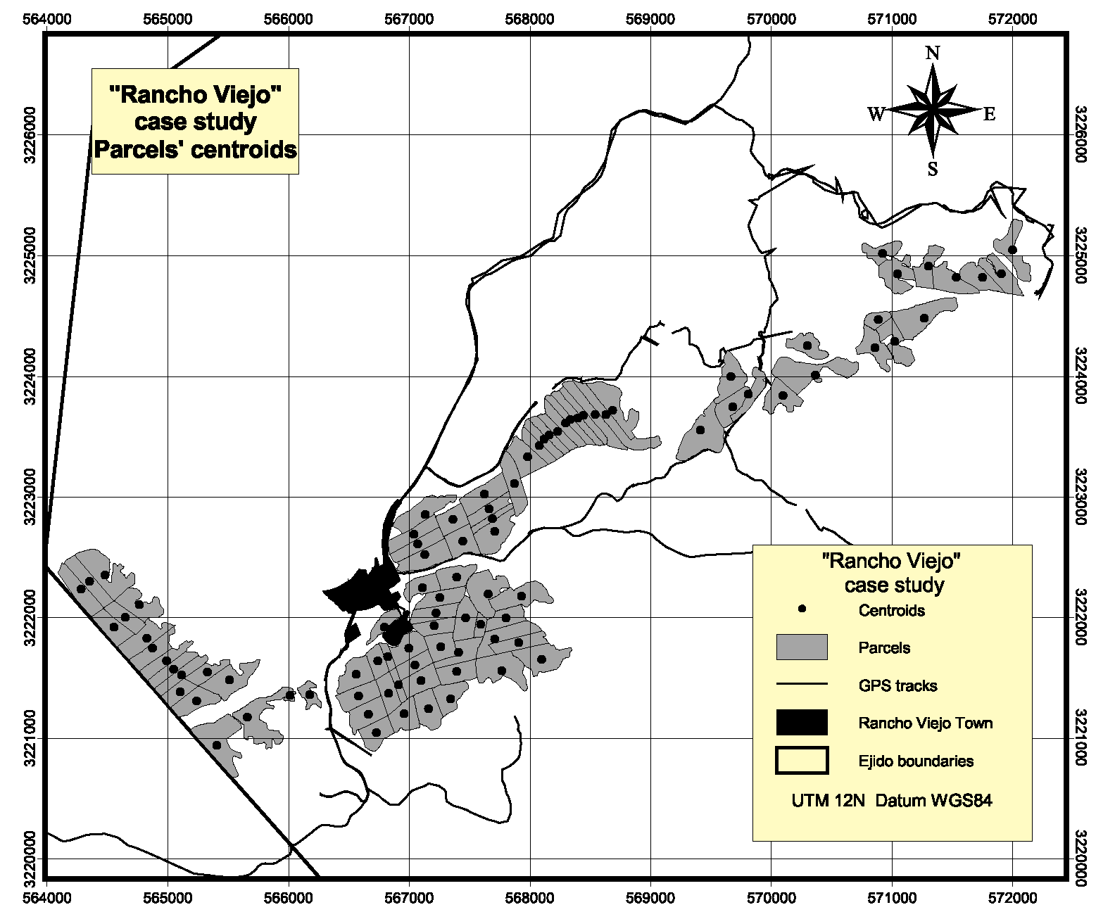
Social networks approach
Strategy 2 hypotheses
Example parcels´ centroids
H 2.3 “ego-networks” surrounding each irrigator within the organizational boundaries are conditional on geographic proximity.

Slide 26
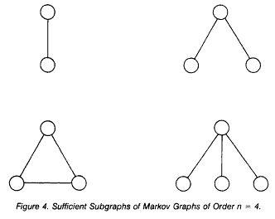
Social networks approach
Strategy 2 hypotheses
Example markov dependence
H 2.4 the likelihood of patner formation between two irrigators exhibit extra-dyadic dependencies. That is ties embedded on triangles are more likely than single ties.
In an ERGM these structures are interpreted simultaneously . That is, 2-stars are part of triangles , and edges are part of 2-stars. Image from: Ove Frank and David Strauss (1986) Markov Graphs. Journal of the American Statistical Association.

Slide 27
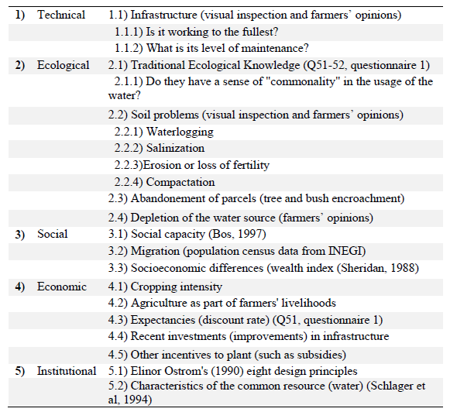
Rapid rural appraisal
TIS sustainability dimensions
Rapid rural appraisal (RRA) is qualitative survey methodology aimed to learn about rural conditions in a cost-effective way (Chambers, 1981; Ison and Ampt, 1992).
It is recommended to make a checklist of the dimensions to look at during the field work.

Slide 28
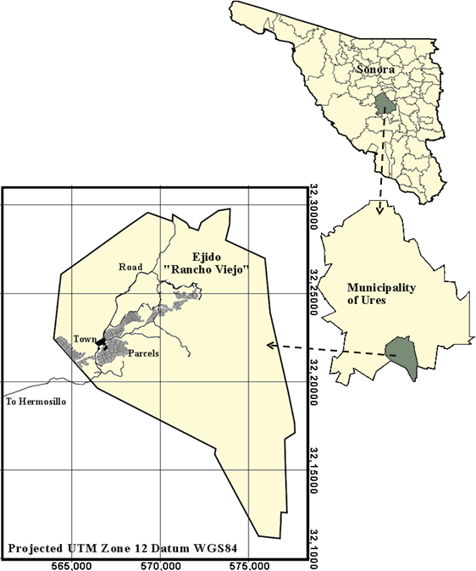
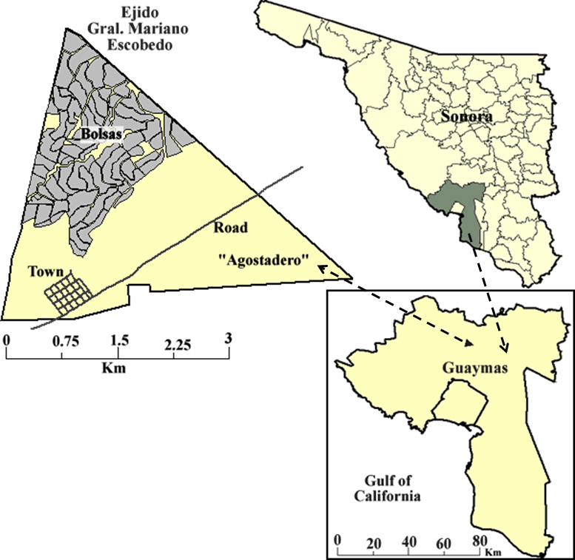
RRA: results
Rancho viejo
General mariano escobedo
Total land = 35,217 acres
Population = 288
Total land = 2504 acres
Population = 147

Slide 29
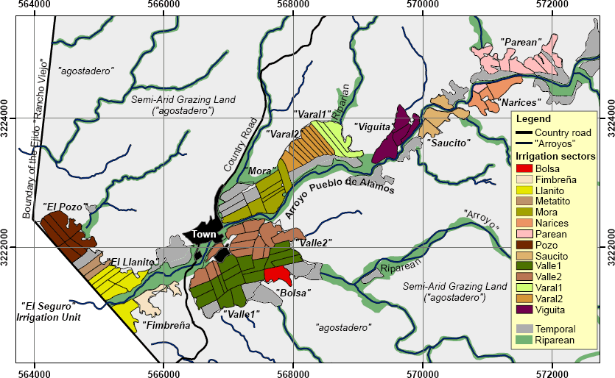
RRA: results
Rancho Viejo

Slide 30
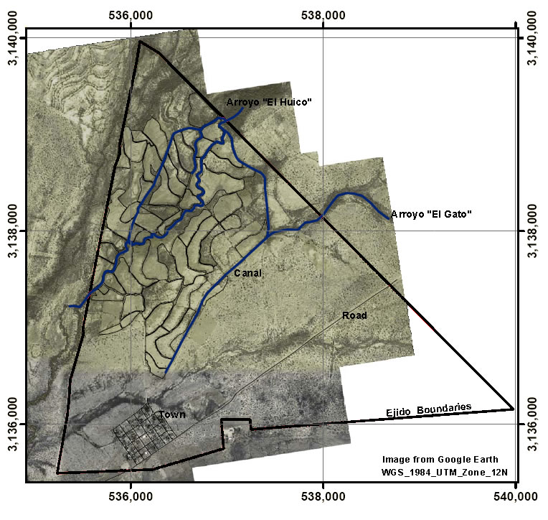
RRA: results
General Mariano Escobedo

Slide 31
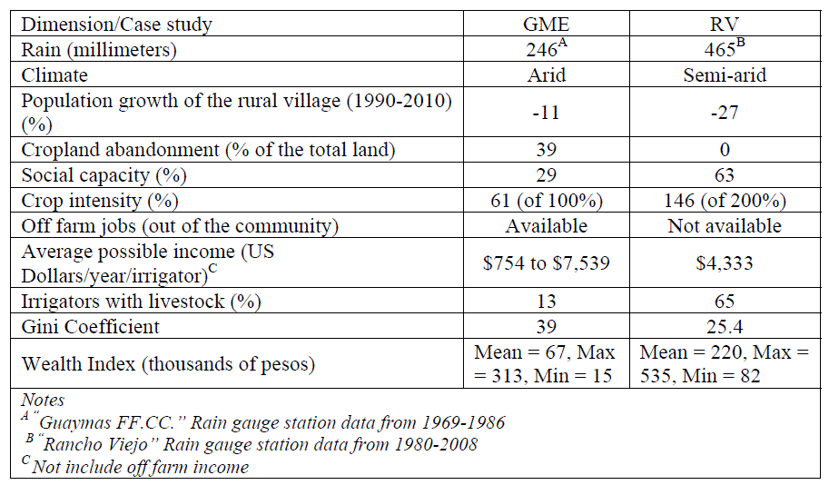
RRA: results

Slide 32
RRA: results
RQ1.1 How successful the local forms of institutions have been overcoming the appropiation and provision issues arising from the use of a CPR?
RQ1.2 What TIS´s socioeconomic and contextual dimensions are affecting the sustainability of the irrigation system?

Slide 33
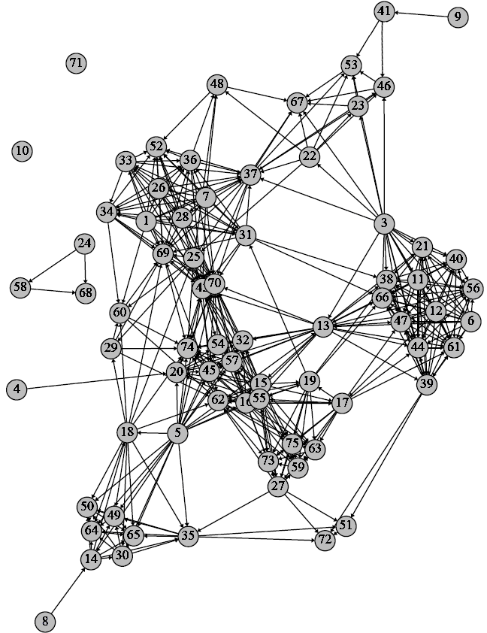
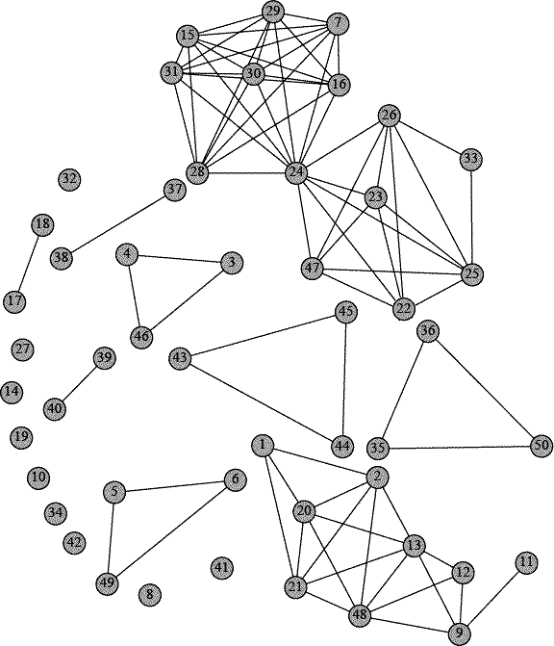
Results: kinship proxy networks
Rancho viejo
gme

Slide 34
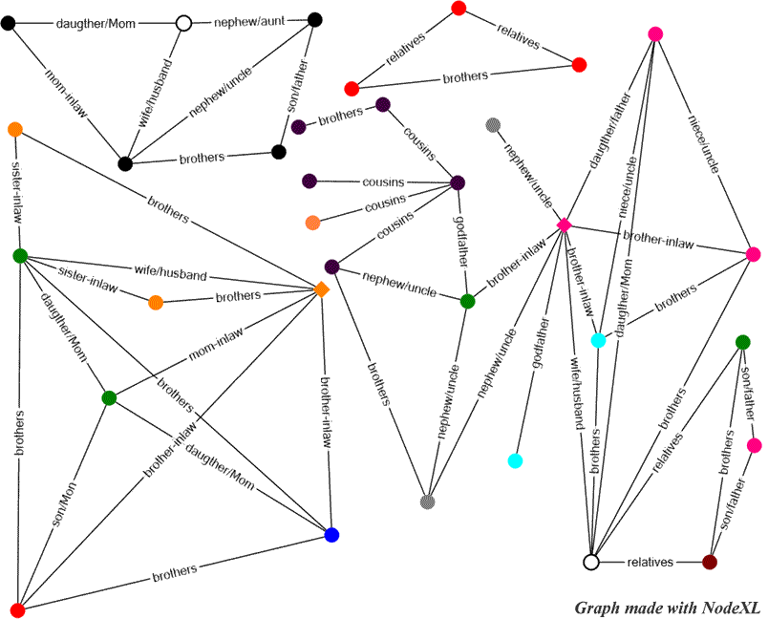
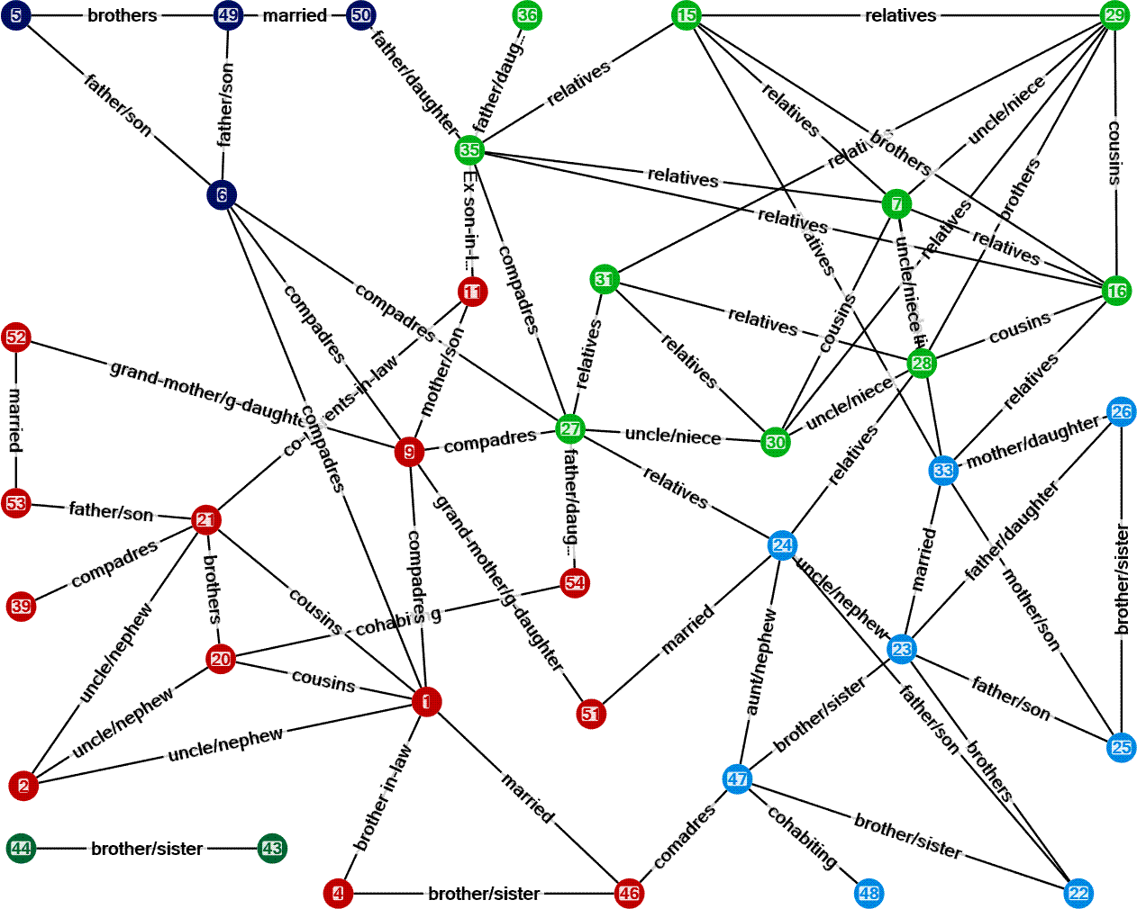
Results: second hand relational data
Rancho viejo
gme

Slide 35
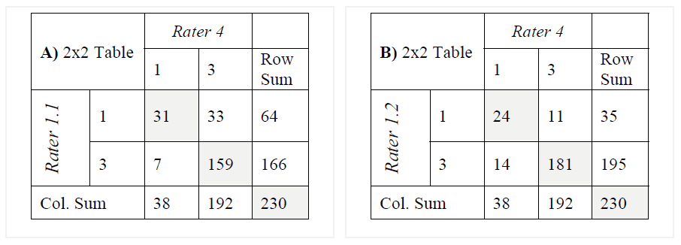
Does proxy kinship network match the empirical data?
Rancho Viejo Case Study
Rater 1.1 = empirical data
Rater 4 = kinship proxy network
1 = “family + in-laws”; 3 = “No family”
Rater 1.2 = empirical data
Rater 4 = kinship proxy network
1 = “family”; 3 = “No family + in-laws”
PABAK Index 0.65 [95% C.I. 0.554 - 0.75] suggesting a substantial agreement

Slide 36
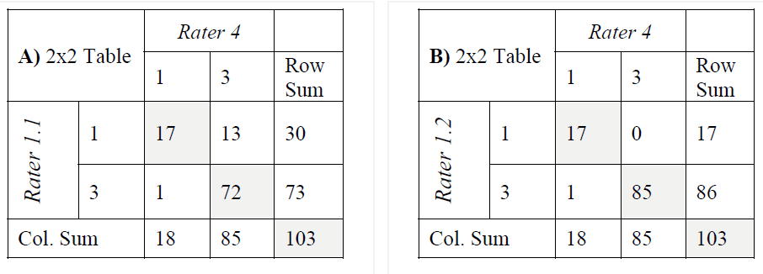
Does proxy kinship network match the empirical data?
GME Study
Rater 1.1 = empirical data
Rater 4 = kinship proxy network
1 = “family + in-laws”; 3 = “No family”
Rater 1.2 = empirical data
Rater 4 = kinship proxy network
1 = “family”; 3 = “No family + in-laws”
Table B the prediction of kinship ties made an excellent agreement with the observed
data. Kappa point estimate was 0.966 [95% C.I. 0.899- 1.033]
suggesting an excellent agreement.

Slide 37
RESULTS
Strategy 1 hypotheses
Hypotheses testing
H 1.1 a proxy kinship network derived from a membership list of a TIS, where persons sharing at least one surname are considered as “direct family”presents a “substantial agreement”with the real family relationships.
H 1.2 It is possible to predict extended family relationships “closing” the triangles formed in the proxy kinship network.
H 1.1 NOT REJECTED
H 1.2 REJECTED
Results not shown

Slide 38
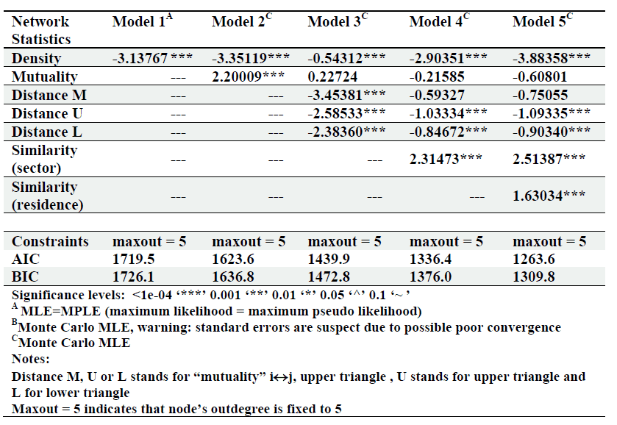
ERGM results
Approximate MLE results for the dyadic independence model for RV
Negative
Negative
Negative
Negative
Positive
Positive

Slide 39
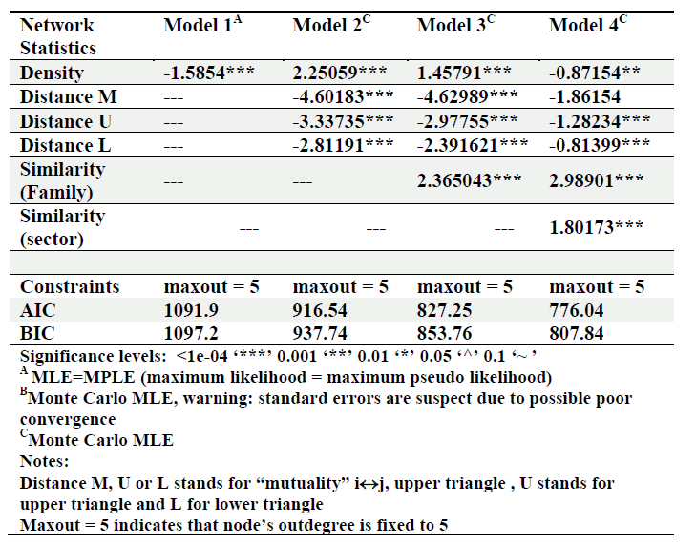
ERGM results
Approximate MLE results for the dyadic independence model for GME

Slide 40
RESULTS
Strategy 2 hypotheses
Hypotheses testing
H 2.1 randomness
H 2.2 family homophily
H 2.3 propinquity
H 2.4 extra-dyadic embeddeness
REJECTED
NOT REJECTED
NOT REJECTED
REJECTED

Slide 41
INTERPRETATION
Geographical proximity.
Irrigation subgroups.
Multiplexity (family).
Triangles found in the network are a by-product of exogenous processes involving nodal attributes.
Are the irrigators socially embedded? Yes
Multiplexity embeddedness.
Dyadic embeddedness.

Slide 42
conclusions
Irrigators´ economic activities of the two case studies are socially embedded on a mesh of family relationships. Geographic proximity and internal subgropus drives their willigness to form partnership ties.
No CPRs issues were present, but there are other forces affecting the long term sustainability of their systems.

Slide 43
Recomendations for further research
To generalize these results a study across cases is needed. This study could take a sample of few ego-centric networks within each case and unveil the composition of them.
Sustainability is a multidimensional variable, so is recommended not to look at a single dimension.

Slide 44
Thank you, questions?

Slide 45
references
Arun, A. (2001) Common Property Institutions and Sustainable Governance of Resources, World Development, Volume 29, Issue 10, October, Pages 1649-1672
Bos, M. G. (1997) Performance indicators for irrigation and drainage. Irrigation and Drainage Systems; 11: 119–137
Chambers, R. (1981) Rapid rural appraisal: rationale and repertoire. Public Administration and Development; Vol. 1, 95-106
Granovetter, M. (1985) Economic action and Social Structure: The problem of embeddedness. The American Journal of Sociology; Vol.91, No.3, (Nov.), pp. 481-510
Hardin, G. (1968) The tragedy of the commons. Science; Vol. 162. pp. 1243—1248
Ison, R. L. and Ampt, P. R. (1992) Rapid Rural Appraisal: A Participatory Problem Formulation Method Relevant to Australian Agriculture. Agricultural Systems; 38 363-386
Robins, G., Pattison, P., Kalish, Y., and Lusher, D. (2007) An introduction to exponential random graph (P*) models for social networks. Social Networks; 29 pages 173-191
Sarker, A. and Itoh, T. (2001) Design principles in long enduring institutions of Japanese irrigation common-pool resources. Agricultural Water Management; 48, 89-102

Slide 46
references
Schlager, E. Blomquist, W. and Shui Yan Tang (1994) Mobile Flows, Storage, and Self-Organized Institutions for Governing Common-Pool Resources. Land Economics Vol. 70, No. 3 (Aug.), pp. 294-317
Sheridan, T. E. (1998) Where the Dove calls, The Political Ecology of a Peasant Corporate Community in Northwestern Mexico. The University of Arizona Press. pp. 237
Shreve, F. and Wiggins, I.L. (1964) Vegetation and Flora of the Sonoran Desert, Volume 1 (Re print of the 1951 book). Stanford University Press
Ostrom, E. (1990) Governing the commons: the evolution of institutions for collective action. Cambridge University Press
Ostrom, E. and Benjamin, P. (1993) Design Principles and the performance of Farmer-Managed Irrigation Systems in Nepal. In: Performance Measurement in Farmer-Managed Irrigation Systems. Manor, S., and Chambouleyron, J. (Eds.) Irrigation Systems: Proceedings of an International Workshop of the Farmer-Managed Irrigation Systems Network, held at Mendoza, Argentina, from 12 to 15 November 1991. Colombo, Sri Lanka, IIMI: XXXIV + 266 pp.
Polanyi, K. (1944) The great transformation: the political and economic origins of our time. Beacon Press books.

